Slide 1
Whether the weather be wet…
“One of the things Ford Prefect had always found hardest to understand about human beings was their habit of continually stating and repeating the obvious, as in It's a nice day, or You're very tall, or Oh dear you seem to have fallen down a thirty-foot well, are you alright? At first Ford had formed a theory to account for this strange behaviour. If human beings don't keep exercising their lips, he thought, their mouths probably seize up. After a few months' consideration and observation he abandoned this theory in favour of a new one. If they don't keep on exercising their lips, he thought, their brains start working. After a while he abandoned this one as well as being obstructively cynical and decided he quite liked human beings after all, but he always remained desperately worried about the terrible number of things they didn't know about.” – Douglas Adams (1979), The Hitchhiker’s Guide to the Galaxy

Slide 2
Whether the weather be wet Or whether the weather be hot We’ll weather the weather Whatever the weather Whether we like it or not!
Anonymous
(I’m Andrew Trotman)

Slide 3
Christmas 2013

Slide 4
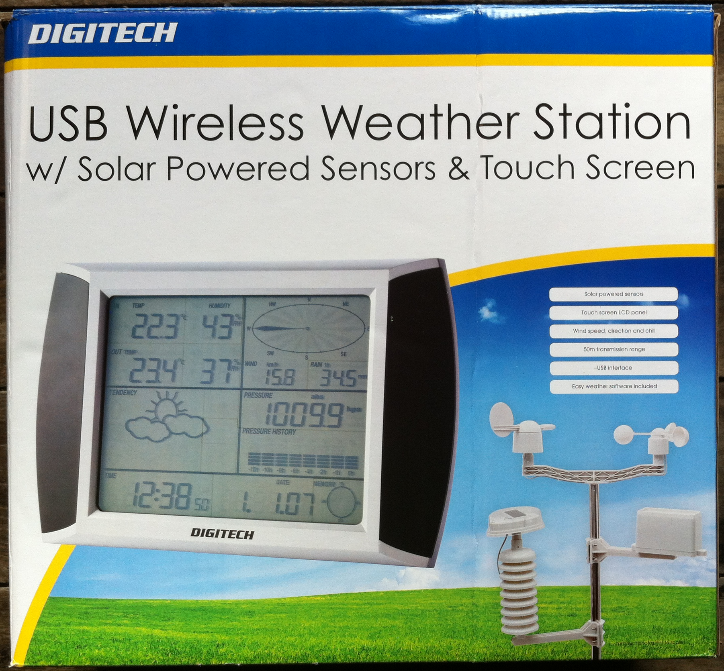
USB Wireless Weather Station

Slide 5
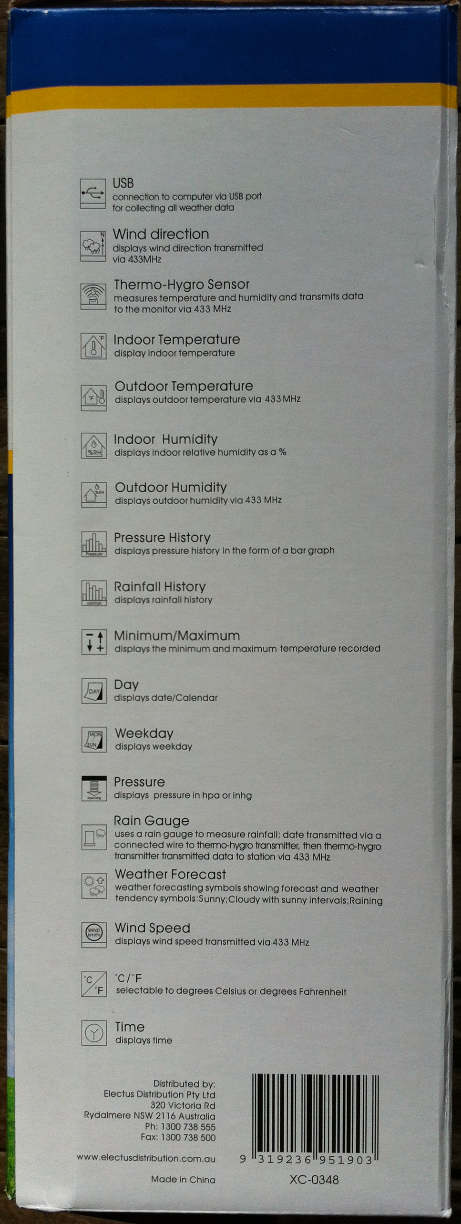
USB Wireless Weather Station
Temperature
Humidity
Cumulative rainfall
Wind speed
Wind direction
Absolute air pressure

Slide 6
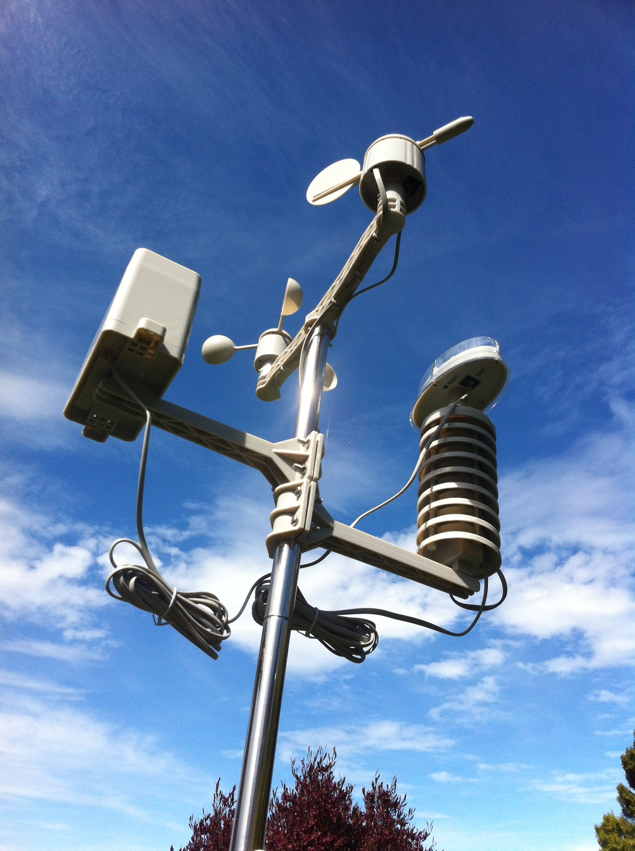
Remote Sensor
Vane
Pluviometer
Anemometer
Photovoltaic
Thermometer
Hygrometer
Transmitter

Slide 7
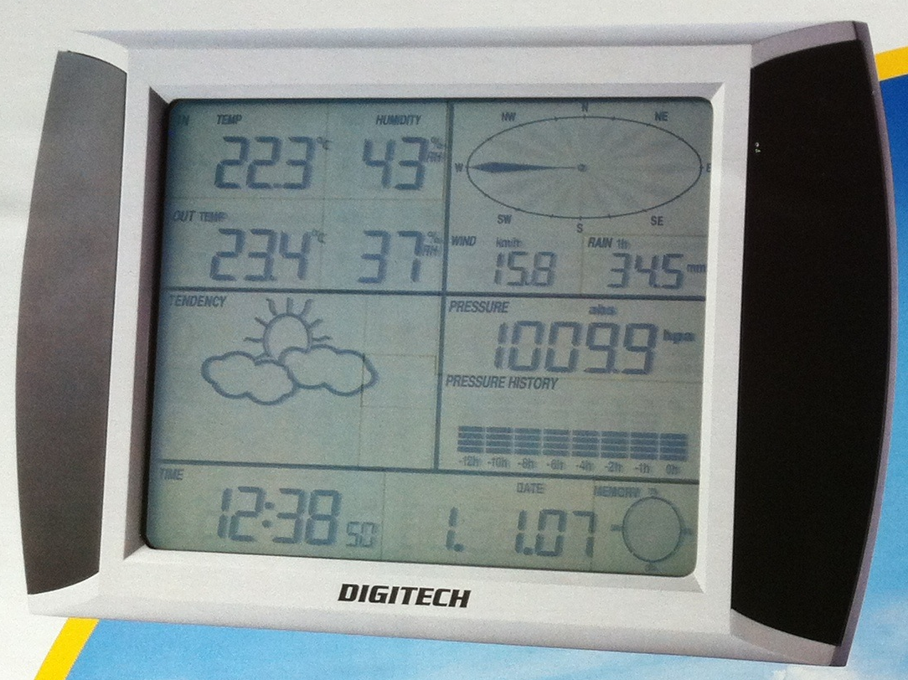
Base Unit
Inside temp / humidity
Wind direction
Outside temp / humidity
Wind speed
Rain
Magic
Air pressure
Magic
Current Time / Date
Memory usage

Slide 8
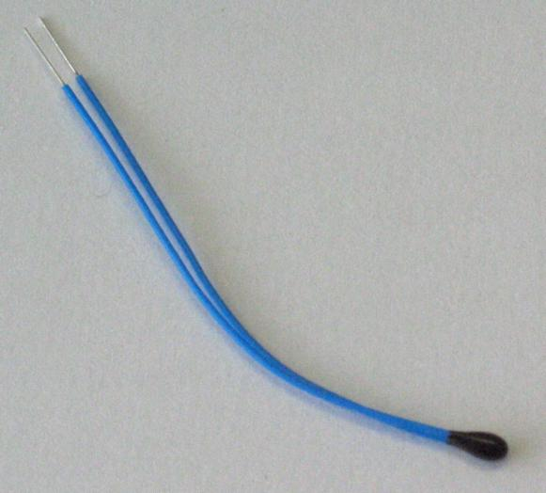
Thermometer
Thermistor
The relationship between resistance and temperature is (1st order) linear
ΔR=kΔT
k = temperature coefficient of resistance
If we know R at a given temperature, and we know k then we can solve for T.
The weather station is accurate to 0.1°C For more accuracy (0.02° over 200°C range) the Steinhart–Hart equation is used:
1/T = A+B ln(R)+C(ln(R))³
http://en.wikipedia.org/wiki/Thermistor

Slide 9
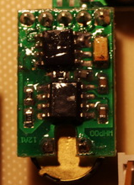
Hygrometer
Probably a capacitive humistor
The dielectric plate of a capacitor is made from a material that absorbs moisture and releases it into the capacitor thus changing its capacitive behavior
To measure humidity, measure the capacitance of the device
Modern versions come on a chip that does all the hard work

Slide 10
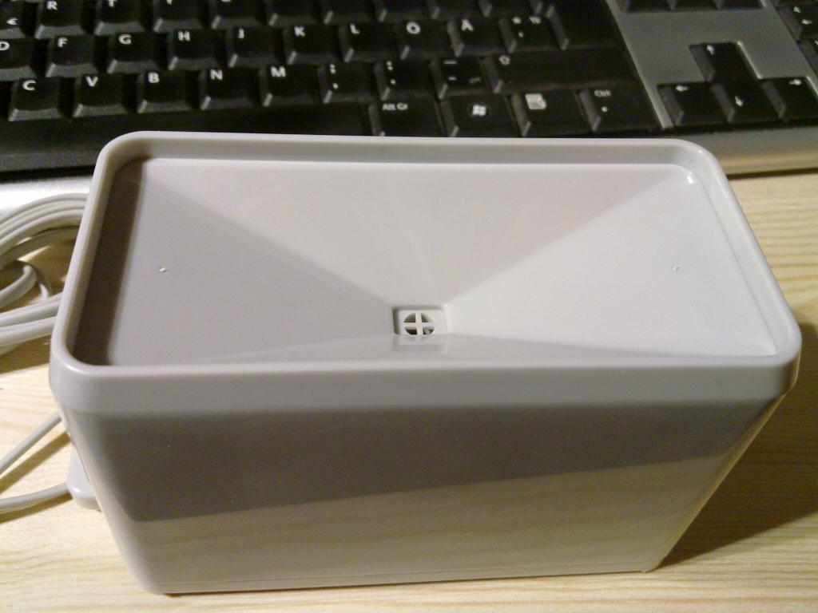
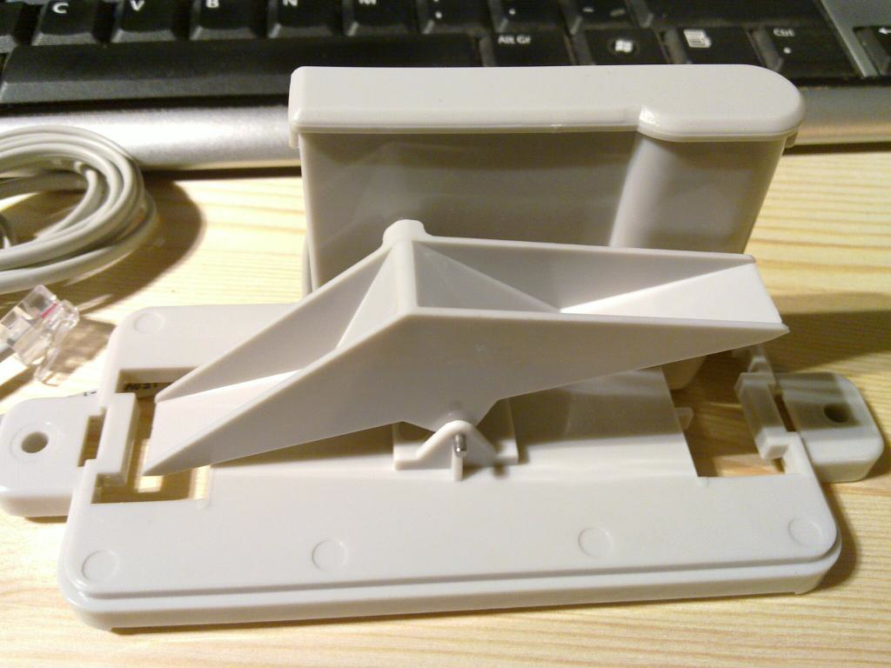
Pluviometer
Simple bucket-tipping seesaw mechanism. Each 0.2794 mm of rain causes a tip.
Each “tip” sends a magnet past a reed switch
A microcontroller counts “ticks”
http://bsd.ee/~hadara/blog/?paged=2
http://bsd.ee/~hadara/blog/?paged=2

Slide 11
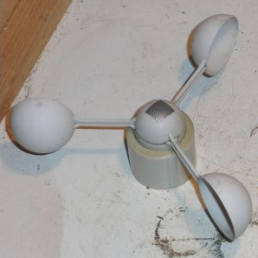
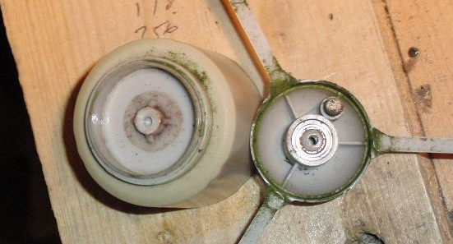
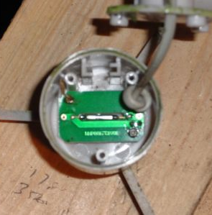
Anemometer
As the cups rotate a magnet passes a reed switch and creates a pulse. A microcontroller counts pulses per second. This board (apparently) pulses twice per rotation.
http://www.digitalham.co.uk/weather/equipment/watson-w8681/wind-speed/

Slide 12
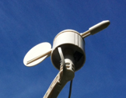
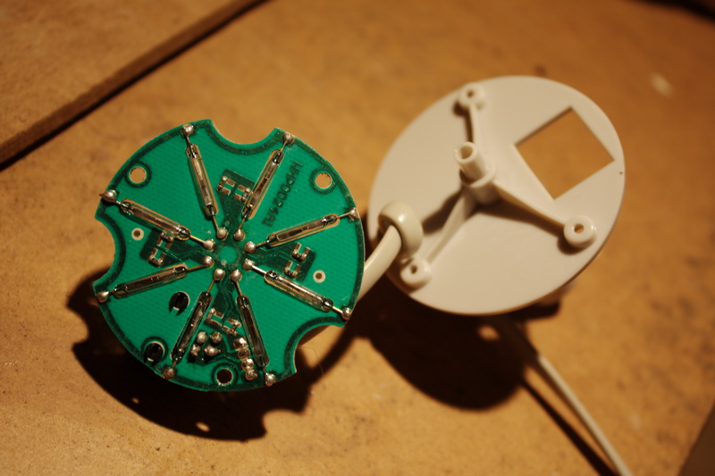
Vane
Digital to analog converter
Reed switches arranged in an octagon
The magnet is on the “pointer”
When the wind blows at most two switches close
Each switch is connected to a different ohm resister
Measure the voltage drop of the circuit to get direction
http://sandaysoft.com/forum/viewtopic.php?f=13&t=492&start=15

Slide 13
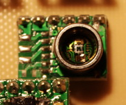
Barometer
Located in the base station
Piezoresistive
As the pressure changes the resistivity changes
http://sandaysoft.com/forum/viewtopic.php?f=4&p=5391

Slide 14
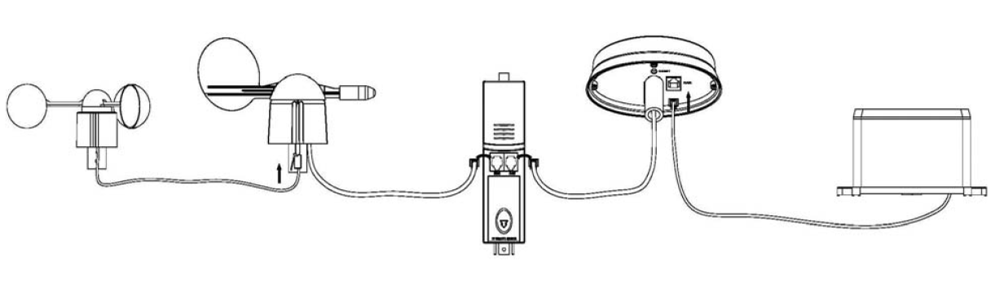
Wire It Up

Slide 15
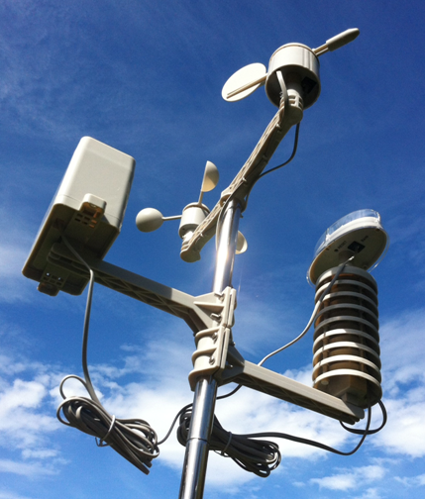
Screw It Up

Slide 16
Wireless Protocol
10 byte packet sent every 48 seconds at 433 MHz
Device identifier
Temperature
Humidity
Average wind speed
Gust wind speed
Rainfall counter
Battery indicator
Wind direction
Checksum

Slide 17
Base Station

Slide 18
USB Wireless Weather Station
The base station can be connected to a PC
Via USB
Software provided on CD-ROM

Slide 19
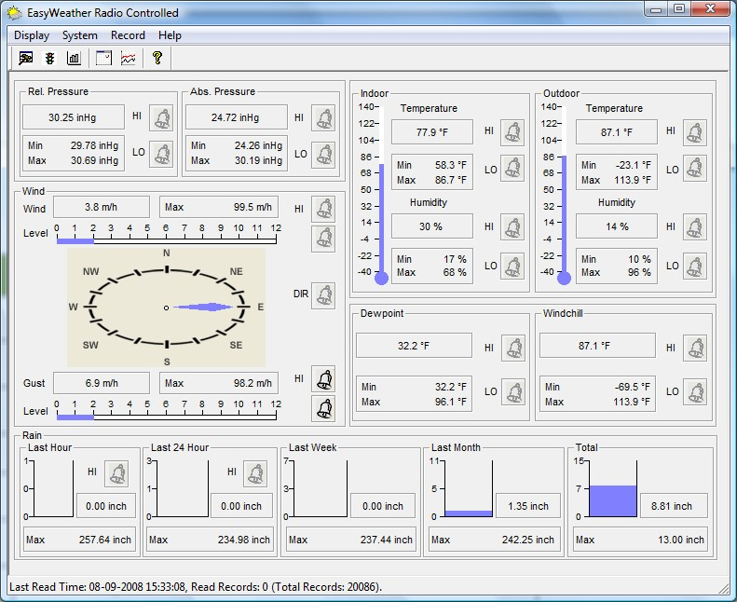
EasyWeather
http://proweatherstation.com/easyweather/easyweather.htm

Slide 20
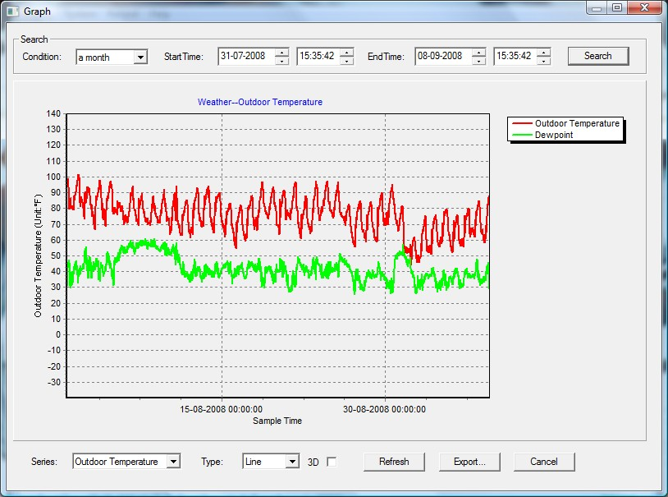
EasyWeather
http://proweatherstation.com/easyweather/easyweather.htm

Slide 21
What I Want (Requirements)
The weather without leaving bed
Weather on my iPhone
Not “24 hour high”
Preferred “today vs yesterday”
Is it warmer today than yesterday?
How much rain did have we had today?
Is the barometric pressure going up or down?
Human readable interpretations
Short-term weather forecasting
(will I need my coat today)

Slide 22
Hacking the USB Protocol
USB HID device
Plug it in to a USB port
lsusb
“WH1080 Weather Station / USB Missile Launcher”
Luckily others had already hacked the protocol
It’s a Fine Offset WH1080 (in a DIGITECH box)
http://code.google.com/p/weatherpoller/wiki/USBProtocol
http://www.jim-easterbrook.me.uk/weather/mm/

Slide 23
i.MX6Q
Our i.MX6Q board is also USB HID
We I have some experience with HID
Open a connection
Sent a “report request”
Receive a “report”

Slide 24
WH1080 USB HID Protocol
I send 8 bytes (1 x USB 1.0 packet)
The device has 64KB “RAM”
Byte | Value | Meaning
0 | 0xA1 | READ
1 | AddrHi | High byte of address
2 | AddrLo | Low byte of address
3 | 0x20 | End of message
4 | 0xA1 | READ
5 | AddrHi | High byte of address
6 | AddrLo | Low byte of address
7 | 0x20 | End of message

Slide 25
WH1080 USB HID Protocol
Device responds with 32-bytes
Byte | Meaning
0 | Minutes since previously stored reading
1 | Base station humidity (%)
2-3 | Base station temperature (x * 0.1 = °C)
4 | Remote sensor humidity (%)
5-6 | Remote sensor temperature (x * 0.1 = °C)
7-8 | Absolute pressure (x/10 = hPa)
9 | Average wind speed (low byte) (x * 0.1 = m/s)
10 | Gust wind speed (log byte) (x * 0.1 = m/s)
11 | Wind speed high byte (top nybble=gust, bottom nybble = average)
12 | Wind direction (x * 22.5 = angle ° from north)
13-14 | Rain bucket “fullness” (x*.3 = mm)
15 | Status (bit 7 = bucket overflow, bit6 = can’t reach remote sensors)

Slide 26
WH1080 USB HID Protocol
First 256 bytes are “special” and includes
Device unique ID
Sample rate (minutes between stored readings)
Number of stored readings
Address of current reading
A load of max, min, display, and alarm settings
Can store 4080 readings in 64KB
85 days at one reading every 30 minutes
There is a USD HID write report to reset stuff (see references)

Slide 27
Hack Time (Exploration)
Web cgi/bin app (on my Windows laptop)
Temperature, humidity, average wind speed, gust wind speed, wind angle, rainfall, absolute pressure
Hourly rainfall: get three readings and subtract the first from the third (similarly for 24 hour)
Wind direction: divide by 22.5 and table lookup
What else…

Slide 28
Wind Strength (Beaufort Scale)
Invented in 1805 by Rear Admiral Sir Francis Beaufort and first used on HMS Beagle
13 point scale (0..12)
Qualitative wind conditions to effects on sails, from “just sufficient to give steerage” to “that which no canvas sails could withstand”
1946
V = 0.836 X B^{3/2} m/s
This is where “force 10 winds” comes from
Calm, Light air, Light breeze, Gentle breeze, Moderate breeze, Fresh breeze, Strong breeze, Moderate gale, Gale, Strong gale, Storm, Violent storm, Hurricane
For Hurricanes use the Saffir–Simpson wind scale

Slide 29
Apparent Temperature
Wind chill
When T < 10°C and V > 4.8 km/h
Developed by the Joint Action Group for Temperature Indices (JAG/TI)
In use in US, UK, Canada from 2001
Computed from model of skin heat transfer assuming bare face, facing the wind, and walking at 5 km/h
T_{a} = 13.12 + 0.6215T – 11.37V^{0.16} + 0.3965TV^{0.16}
Somewhat controversial

Slide 30
Apparent Temperature
Heat index
Steadman, R. G., 1979 J. Appl. Meteor., 18, 861–885.
When humidity is high perspiration is less effective
So It feels hotter
When T > 27°C, H > 40%, DewPoint > 12°C
Assuming in shade with no wind
Compute from a model including 20 parameters such as skin, clothing, temperature, humidity, activity, etc.
T_{a} = c1 + c2T + c3R + c4TR + c5T² + c6R² + c7T²R + c8TR² + c9T²R²

Slide 31
Dew Point
“The dew point is the temperature at which the water vapor in air at constant barometric pressure condenses into liquid water at the same rate at which it evaporates” (Dew point (visited 2014) Wikipedia)
In other words, if the temperature gets lower than the dew point water condenses

Slide 32
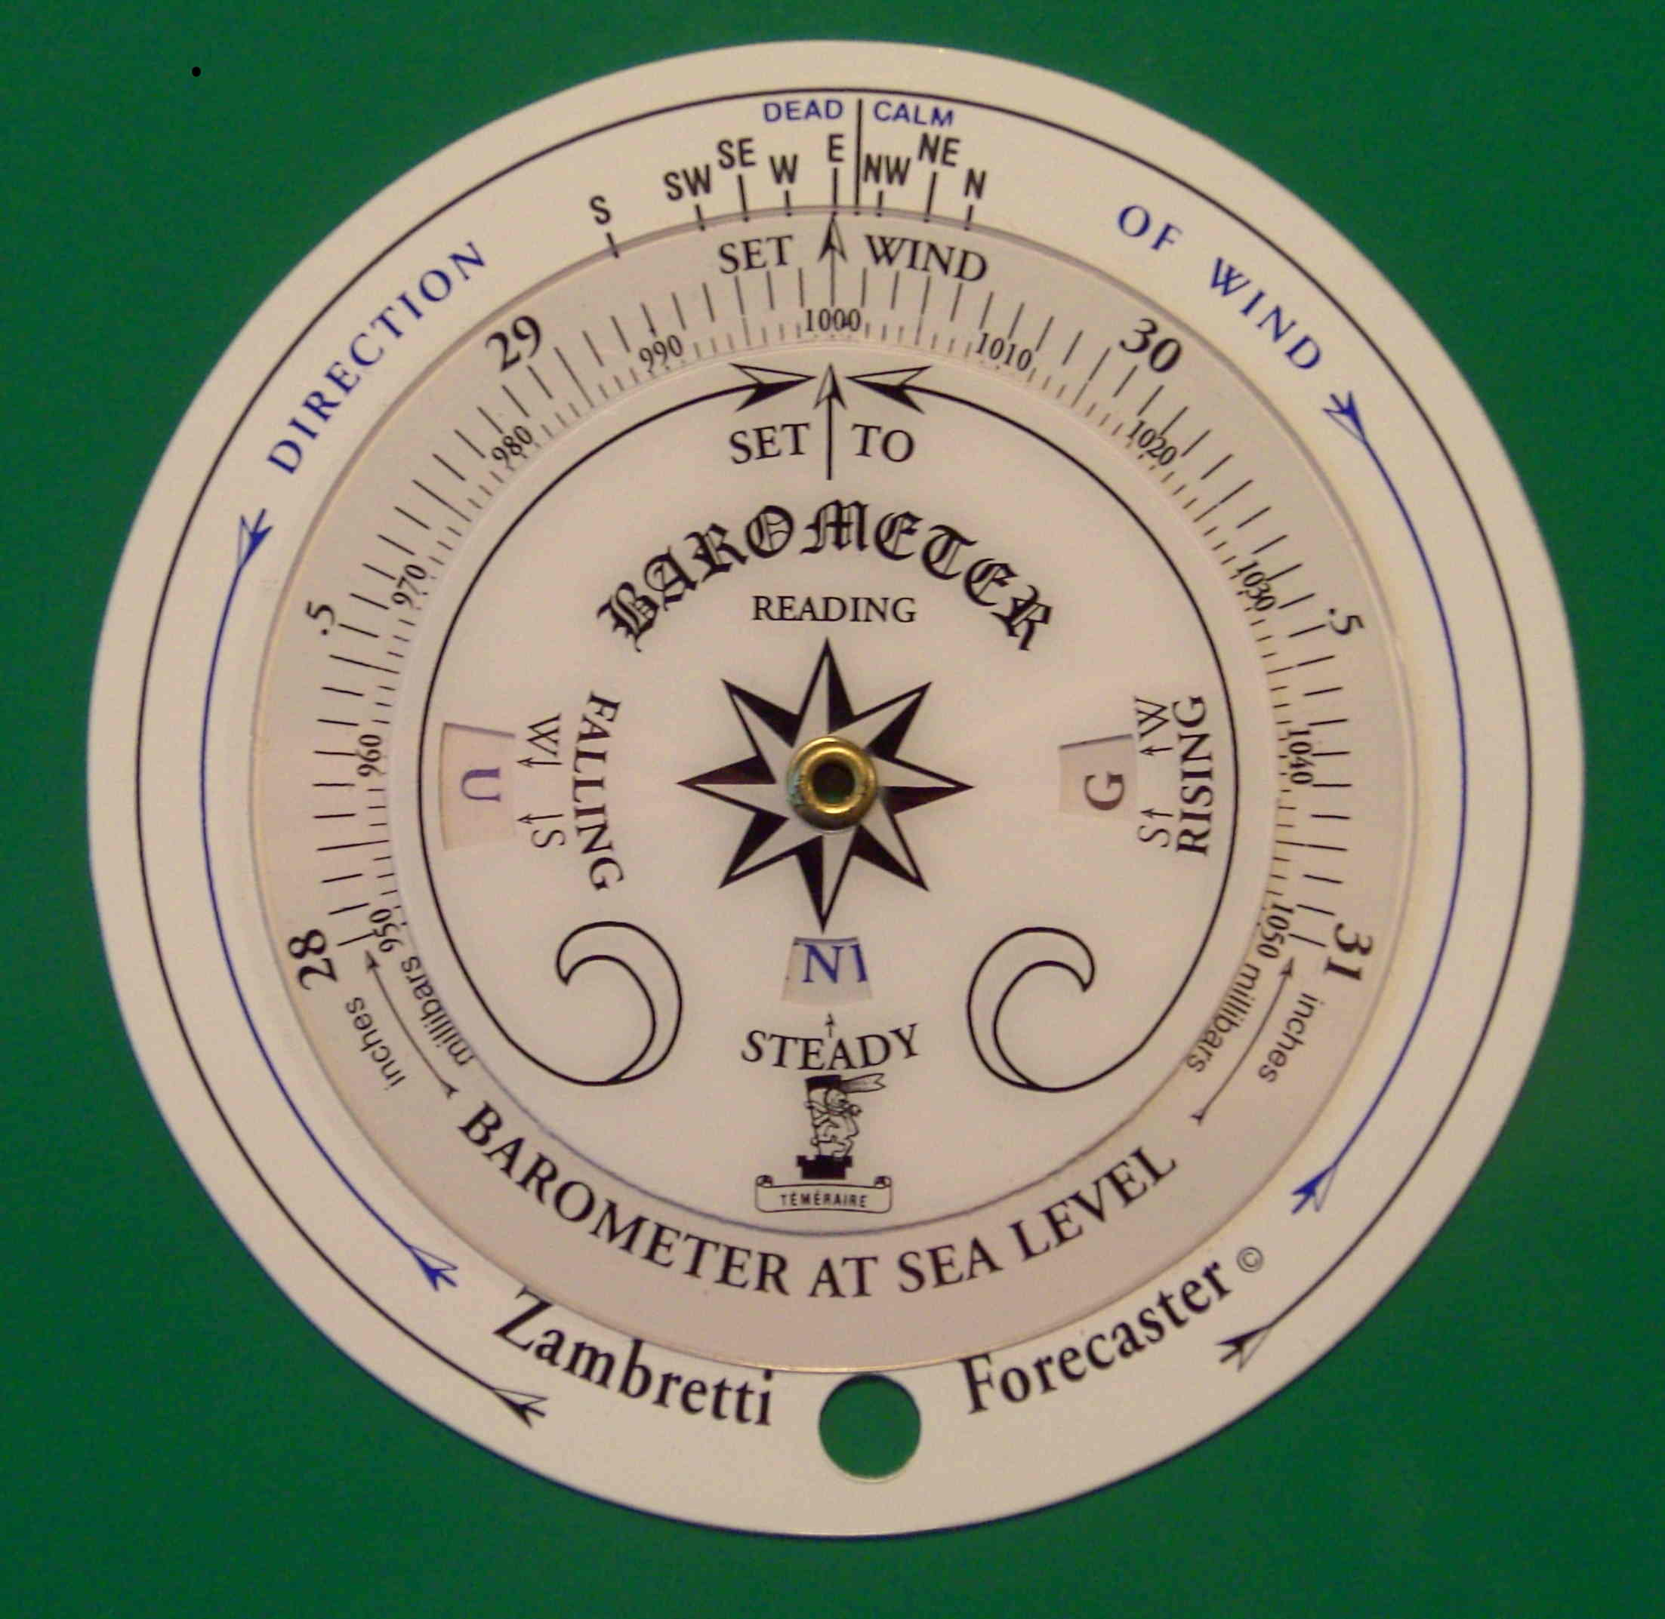
Weather Forecasting
Negretti & Zambra (1915) Zambretti Forcaster
3 disk system using
Wind direction
Sea level adjusted barometric pressure
Barometric direction (rising, falling, steady)
Season (summer / winter)
Adjusted to include:
Earth Hemisphere
Direction of equator (warmer wind)
http://www.meteormetrics.com/zambretti.htm

Slide 33
Zambretti Forcasts
Settled fine
Fine weather
Becoming fine
Fine becoming less settled
Fine, poss showers
Fairly fine, improving
Fairly fine, poss showers early
Fairly fine, showery later
Showery early, improving
Changeable, mending
Fairly fine, showers likely
Rather unsettled clearing later
Unsettled, prob improving
Showery, bright intervals
Showery, becoming more unsettled
Changeable, some rain
Unsettled, short fine intervals
Unsettled, rain later
Unsettled, rain at times
Very unsettled, finer at times
Rain at times, worse later
Rain at times, becoming v. unsettled
Rain at frequent intervals
Very unsettled, rain
Stormy, poss improving
Stormy, much rain

Slide 34
What else?
Sunrise / sunset
Moon phase

Slide 35
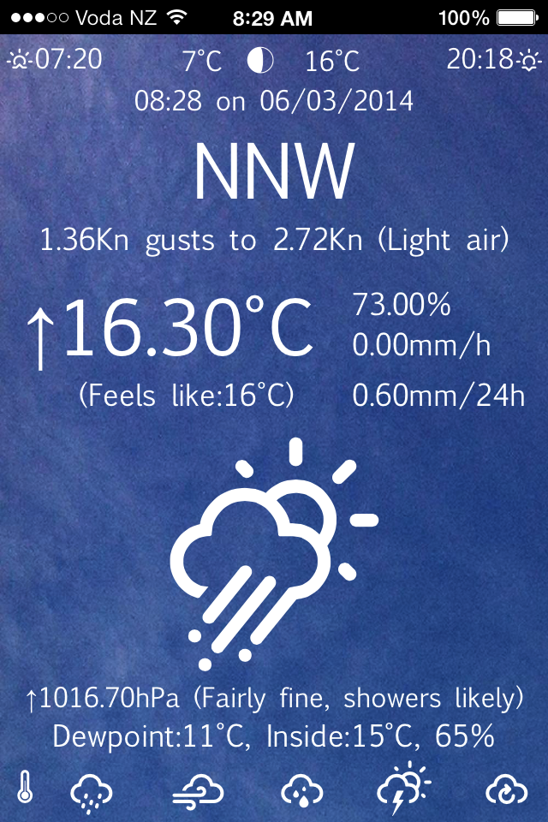
Finished Web App
Sunrise
Sunset
24 Hour low
24 Hour high
Phase of moon
Time and Date (now)
Wind Direction
Wind speed
Beaufort scale
Temperature
Humidity
Temperature change
Hourly total rain
Apparent temperature
24 hour total rain
Magic
Sea level adjusted pressure
Forecast
Pressure change
Base station details
Dew point
Graphs
Refresh

